Slide 1
JEE Project
Team 01
Musiqua!

Slide 2

JEE Project
Putting into practice the knowledges from JEE classes and labs.

Slide 3
Plan
Team
Use cases
Technical choice
Results
Improvement and experience
Demo

Slide 4


AMADOU
Asmaou
GESLOT
Baptiste
GAZZOLA
Francesco
XICOLA
Charles

Slide 5
Use Cases
Access the catalog
Listen to content (simulation)
Modify personal information
Authentification
Add content to playlists
Create an account
Manage the customers
Manage the content

Slide 6
Technical choices…
Softwares and languages involved :
Eclipse
MySQL
GitHub
GitKraken
Teams
Discord
Use of a design pattern :
MVC
(Model-View-Controller)

Slide 7
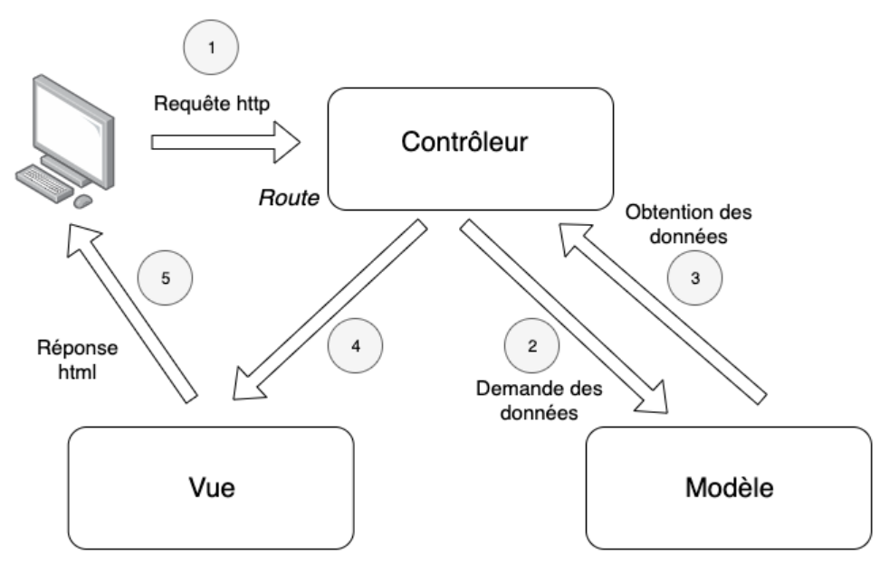
Technical choices : MVC
Necessity to use a MySQL connector to communicate with the DB

Slide 8
Results
Functionalities availables :
Access the catalog
Listen to content (simulation)
Authentification
Add content to playlists
Manage the content
Create an account

Slide 9
Improvements & experience

Slide 10
Demo

Slide 11
Question time.

